Slide 1
Leaf Disease Detection Using Deep Learning
Paper ID:- IWCSET20-CSE-057
Keywords— leaf image, agricultural tips, convolutional neural network
Authors :
Onkar U. Kadam
Kshitij G. Bargale
Sanket J. Bendale
Prof . N. S. Deokule
Department of Information Technology,
Government College Of Engineering, Karad

Slide 2
AGENDA
Motivation
Introduction
Problem Definition
Architectural Diagram
Methodology
Working
Advantages
Experimental Results
Future Work
References

Slide 3
Motivation
India is an Agriculture based country. Wherein 70% of the population depends on Agriculture. When pests and diseases affect the crops, there will be a tremendous decrease in production. In most of the cases pests or diseases are seen on the leaves or stems of the plant.
Nearly all the farmers are surrounded with the technology.

Slide 4
Introduction
- Genuine advantages of innovation have not been reached to the townspeople.
- Proposed model will focus on well being of farmers.
- The farmers can use this model remotely from anywhere, any time.

Slide 5
Problem Definition
- Developing real time software model using deep learning for detection of leaf disease.
- It will allow users to give agricultural tips according to the season.
- It will allows users to classify whether the plant is healthy or diseased.
- In case of diseased leaf, it will provide suggestions like suitable pesticides.

Slide 6
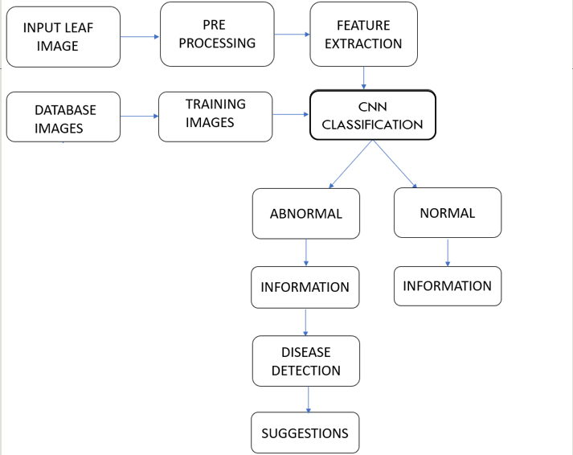

Architectural Diagram
SUGGESTIONS

Slide 7
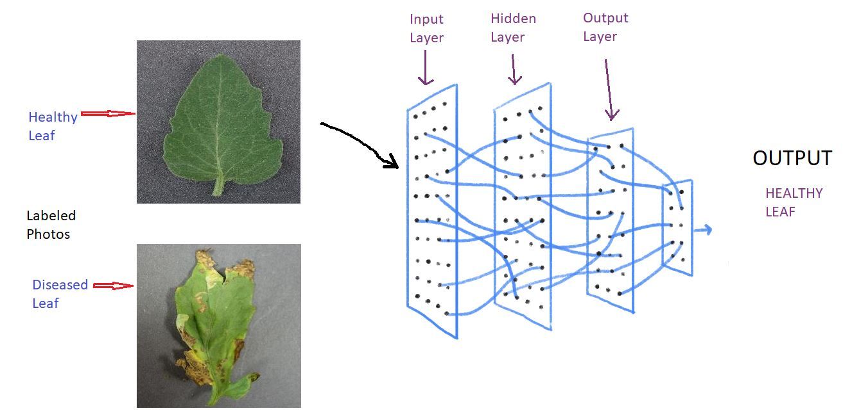
Methodology

Slide 8
Convolutional Neural Network
consists of convolutional layers along with pooling layers.
Feature maps are extracted through convolution and other processing layers from image.
Gives output from the estimated class.
Loss – difference between actual and predicted
Backpropagation Method

Slide 9
Steps
Creating Dataset:
The code is basically divided into four steps:
Importing Libraries
Generation of Data
Making Neural Network
Predicting the model (results as healthy or diseased).
Data
Train
Validation
Infected
Non-infected
Infected
Non-Infected

Slide 10
Working
Libraries used – Keras with Tensorflow as a backend.
Division of pixel values
Using cross-entropy loss metric
Epoch Condition
Feature Extraction Layers
Activation Function

Slide 11
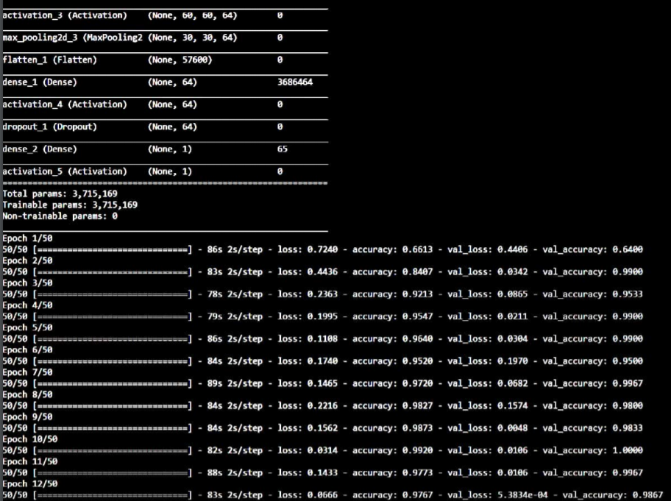
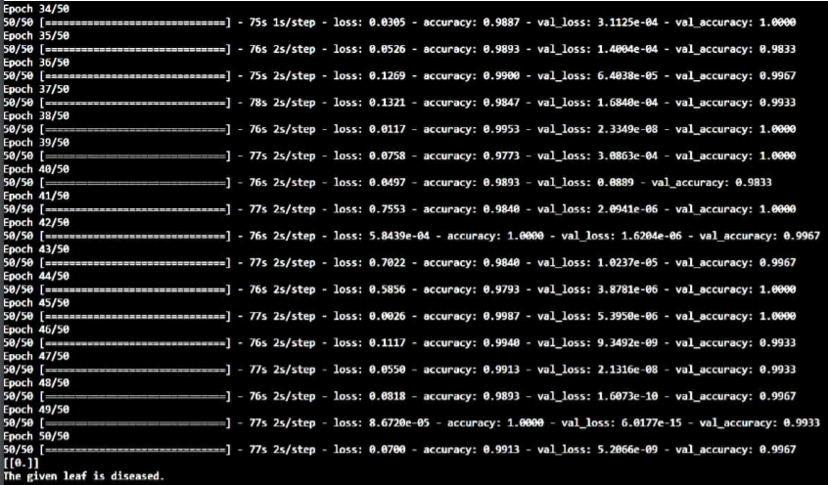
Experimental Results

Slide 12
Advantages
- Easy to use
- Reduces time
- Reduces Human Efforts
- Expert Suggestions

Slide 13
Future Scope
- Building Real time mobile application.
- Make this model available in different regional languages so that it is convenient for everyone.

Slide 14
References
- Yosuke Toda, Fumio Okura, “How Convolutional Neural Networks Diagnose Plant Disease”, 2019
- R. Balodi, S. Bisht, A. Ghatak, and K. H. Rao, “Plant disease diagnosis: Technological advancements and challenges,” Indian Phytopathology, vol. 70, no. 3, pp. 275–281, 2017.

Slide 15
THANK YOU

